Slide 1
Mathematical Modelling:
The Lotka-Volterra Model
Rouzhen Ma
Stephanie Young(Mentor)

Slide 2
“How many are there?”
Animal
Capture
Mark
Recapture
Notes:
Back to our middle school. We first getting in touch with predator and prey in math class is to help ecologists to find out population of species. Capture and mark individuals in one sample, take a second sample in which there is a chance that the same individual can be recaptured. Then using probability, we can get the answer.
However, actual situations are much more complex than that.

Slide 3
Predator-Prey System
P(t)=The number of predators at time t
N(t)=The number of its prey at time t
The rate of change of the prey population
N’(t) = aN(t) - bN(t)P(t)
Notes:
Here we introduce the predator-prey system: P(t) is.. N(t) is...
aN(t) is the growth rate, -bN(t)P(t) shows the effects of predation, which is negatively related to both the number of predators and prey.
a, b are nonnegative constants

Slide 4
Predator-Prey System
The rate of change of the predator population
P’(t) = -dP(t) + cN(t)P(t)
Notes:
-dP(t) shows the effect of mortality, cN(t)P(t) is the growth from predation

Slide 5
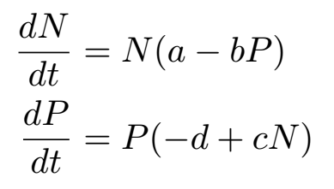
The Lotka-Volterra Model
First-order
Nonlinear
Autonomous
Equilibrium: P=a/b, N=d/c; P=N=0
Notes:
Altogether, we get the lotka-volterra model
It is first order, nonlinear(since it has NP terms) and autonomous, which means it doesn’t depend explicitly on time
Here, we get two equilibriums: one is when P=a/b and N=d/c, another is when P=N=0 (no population, trivial)
It achieves its equilibrium when the population is stable and unchanging, or to say, when the rate of death equals to the rate of birth
For the second equilibrium, it doesn’t mean anything, so we can just ignore it

Slide 6
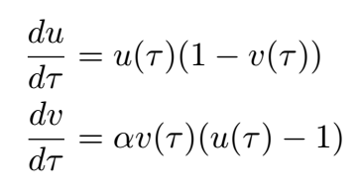
Rescaling the System
τ=at
u(τ)=(c/d)N(t)
v(τ)=(b/a)P(t)
α=d/a
Equilibrium: u=v=1
Notes:
In order to further analyze the model, we have to rescale it because for now we have four parameters, which is too much. By rescaling using the scheme, we are left with only one parameter. And this is our rescaled lotka-volterra system
The equilibrium also shifts, from d/c and a/b to where u=v=1, which is a steady status
(explain how do we get the new eqm)

Slide 7
Behavior around the equilibrium:
Linearization
Linearized System
Notes:
To understand dominate behavior around the equilibrium, we need to linearize
Here the partial derivatives of the functions f and g are evaluated at the equilibrium point (x0, y0).
This linearization shifts the equilibrium to the point zero in the X, Y coordinates

Slide 8
Behavior around the equilibrium:
Linearization
Linearized Lotka-Volterra Model at (1,1)
Set U=u-1, V=v-1
Final result
Notes:
here, we set U=u-1 and V=v-1 because linearization is based on the Taylor expansion and we want to expand around the equilibrium (1,1)
Applied to lotka-volterra model at equilibrium (1,1).

Slide 9
Solving Linear system
Eigenvalues
|A-λI|=0
solving the quadratic equation for λ
Eigenvectors
(A-λI)v=0
Solving for the associated eigenvectors
Notes:
to solve the linear system. We find eigenvalues by solving the quadratic equation for λ, and then solving for the associated eigenvectors
(I is the identity matrix)

Slide 10
Solving Linear system
how to find eigenvalues/eigenvectors in our system?
Notes:
show you how to linear our system

Slide 11
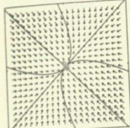
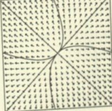
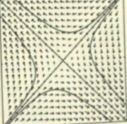
Classification of the Equilibria
Real Eigenvalues: λ₁, λ₂ <0 → Stable node
Real Eigenvalues: λ₁, λ₂ >0 → Unstable node
Real Eigenvalues: λ₁ < 0 < λ₂ → Saddle point
Notes:
So last step is to classify the equilibria. There are six types of equilibria. For real eigenvalues, if both are negative, the equilibrium is a stable node; solutions will decay to 0. If both positive, the equilibrium will be an unstable node. The solutions of the system will grow to infinity. The third case is a saddle point when one eigenvalue is positive and another is negative. It is unstable as it compressed in one direction but grow to infinity in the other directions

Slide 12
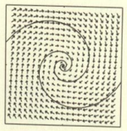
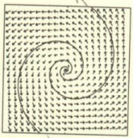
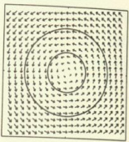
Classification of the Equilibria
λ1=α+βi, λ2=α+βi
Complex Conjugate Eigenvalues: α<0 → Stable spiral
Complex Conjugate Eigenvalues: α>0 → Unstable spiral
Complex Conjugate Eigenvalues: α=0 → Centres
Notes:
For complex conjugate eigenvalues, there are also three cases. With stable spirals, solutions will decay towards the origin. With unstable spirals, the solutions will spiral outwards away from the equilibrium. The last one is centre, with solutions that form concentric ellipse.
Our model is like a centre (periodic orbit/trajectory)

Slide 13
Limitations
The equilibrium is a centre, which is structurally unstable
General upper limit
Improve: The Logistic Growth Law
Improve: The Logistic Growth Law
Notes:
The model has some limitations. The equilibrium is a centre and it is structurally unstable. If we disturb the system, it will no longer be a centre and it will spiral in or out. Also,This model doesn’t take into account the fact that prey population has a general upper limit.
There are several ways to improve the model, one is to apply the logistic growth law. Maybe I will leave it to next semester.

Slide 14
Any questions?

